Slide 1



Smoker Status Prediction
Here is where our presentation begins
SIC 602
Team 17
Facilitator : Yasmeen

Slide 2

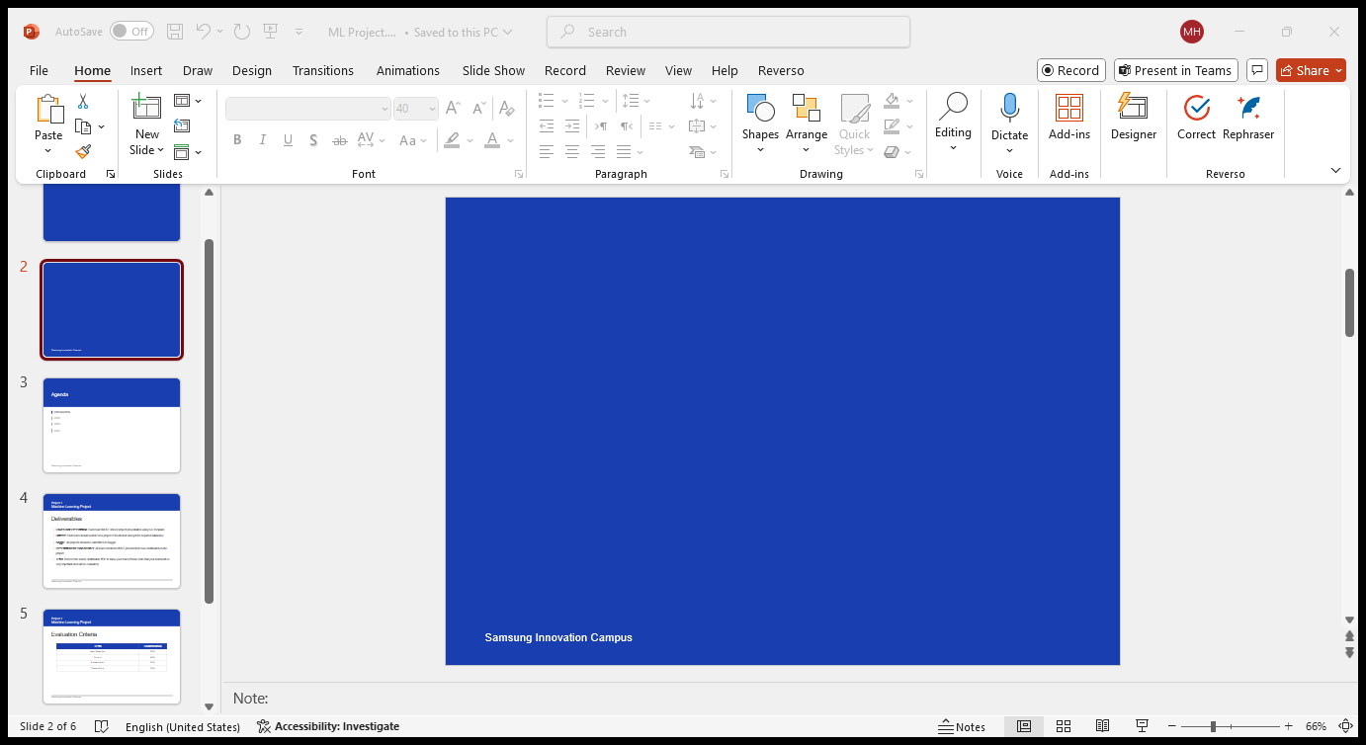
TABLE OF CONTENTS
01
04
05
02
06
07
INTRO
EDA
Here you could describe the project
Here you could explore the dataset
Data Preprocessing
& solving data problems
Project Target
Modeling
03
Data Description
Here you could know
the data
Business insights

Slide 3

01.
INTRO

Slide 4

Smoking harms nearly every organ, causes numerous diseases, and reduces life expectancy. Despite the availability of smoking cessation treatments, long-term success rates are low.

Slide 5
02.
Project Target

Slide 6
A group of scientists are working to develop predictive models targeting smoking status. Our task is to assist them by building a machine learning model that can accurately identify an individual's smoking status based on various bio-signals.

Slide 7
03.
Data Description

Slide 8
Age: 5-year intervals
Height: in cm
Weight: in kg
Waist Circumference: Indicator for abdominal obesity
Eyesight: Left and right eye vision
Hearing: Left and right ear ability
Blood Pressure: Systolic (upper), Diastolic (lower)
Fasting Blood Sugar: Key diabetes risk indicator
Cholesterol: Total cholesterol level
Triglycerides: Blood fat level
HDL & LDL: Good and bad cholesterol
Hemoglobin: Blood health indicator
Serum Creatinine: Kidney function marker
Liver Enzymes: AST, ALT, GTP
Smoking: Target variable (smoker/non-smoker)

Slide 9
04.
Exploratory Data Analysis
Univariate Analysis
Bivariate Analysis
Multivariate Analysis

Slide 10
Univariate Analysis
The dataset contains numerical and categorical features
The data is on 38,983 person with 23 different feature
There are no missing valuse
There are no duplicate entries

Slide 11
Summary of imp. Descriptive Statistics
1. Age Distribution: Most individuals are between 40-55 years old, with an average age of 44, spanning from 20 to 85.
2. Physical Attributes: Average height is 165 cm, weight 67 kg, and waist circumference 83 cm..
3. Health Metrics:
- Blood Pressure: Average systolic is 122 mmHg, and diastolic 76 mmHg.
- Cholesterol: Mean cholesterol is 195, near the upper end of the normal range.
- Triglycerides and LDL show variability, indicating possible risk cases.
4. Smoking: 44% of individuals are smokers, indicating a significant smoking population.
5. Hearing and Eyesight: Normal hearing overall, but eyesight varies with some extreme cases.
6. Biomarkers: Liver enzymes (AST, ALT, GTP) show variability, suggesting potential liver function issues in some individuals.

Slide 12
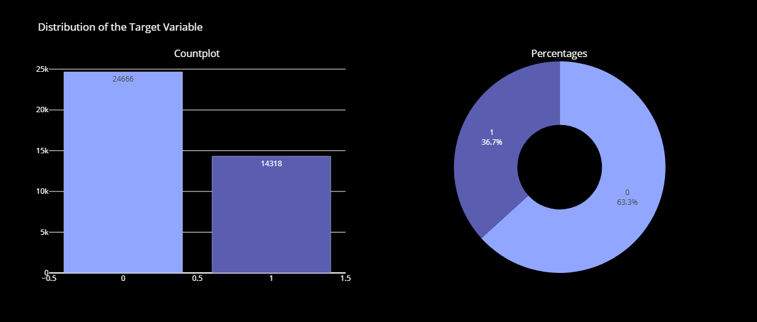
Univariate Analysis
The distribution of the smoking column shows that 63.3% of the individuals are non-smokers (0s), while 36.7% are smokers (1s). This indicates a class imbalance in the target variable, with more non-smokers than smokers.

Slide 13
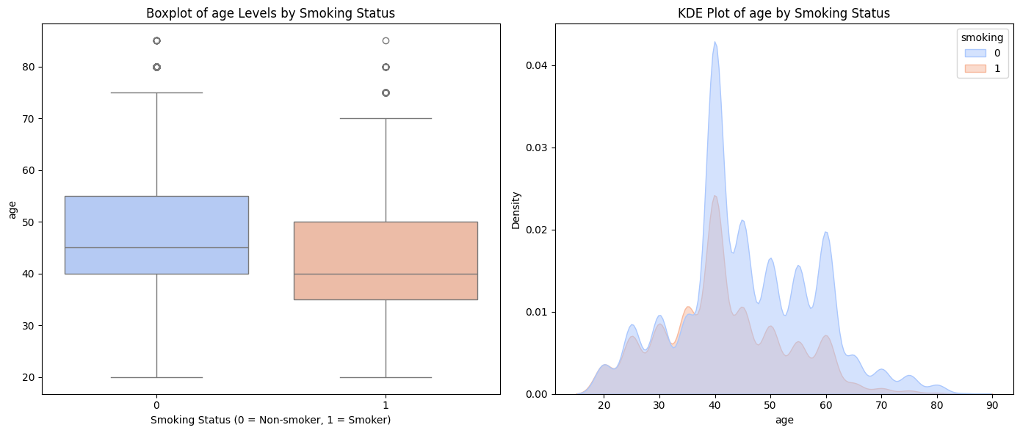
Bivariate Analysis
Smoking is more prevalent among younger age groups, while non-smoking becomes more common in middle-aged and older individuals, with the gap widening as age increases.

Slide 14
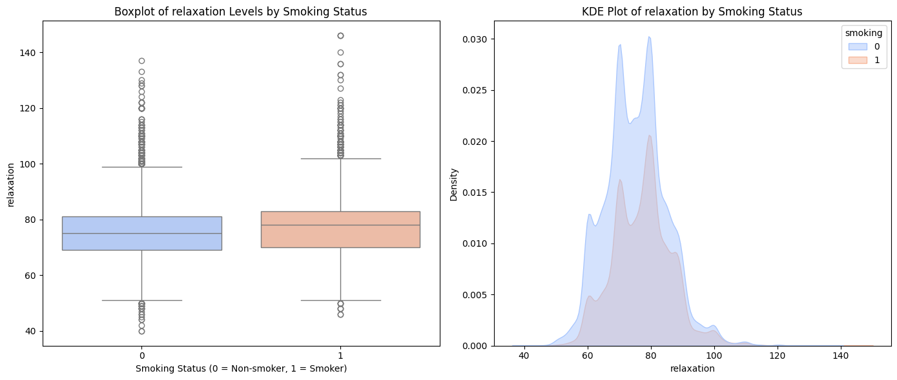
The relaxation distributions between smokers and non-smokers were very similar. This was surprising to me.
Bivariate Analysis

Slide 15
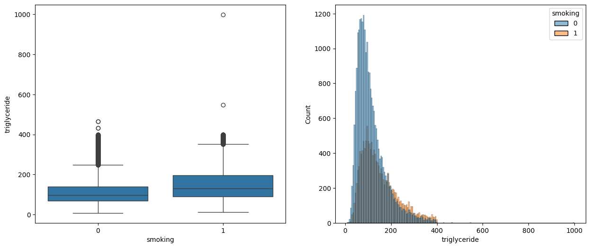
Smokers tend to have slightly higher triglyceride levels compared to non-smokers, with more outliers among smokers.
Bivariate Analysis

Slide 16
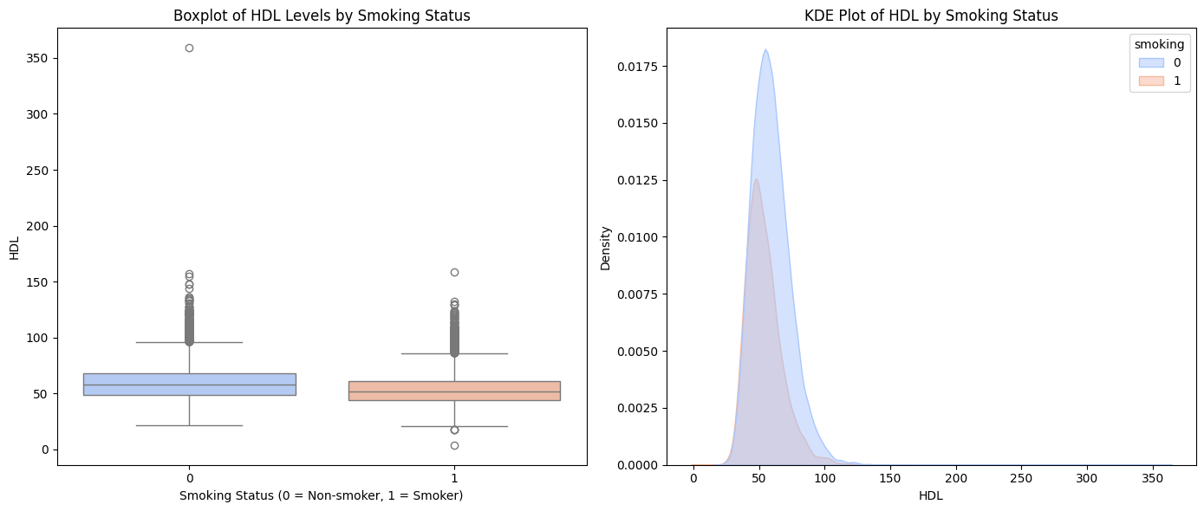
From the above charts, we see that non-smokers, on average, have higher HDL than smokers.
Bivariate Analysis

Slide 17
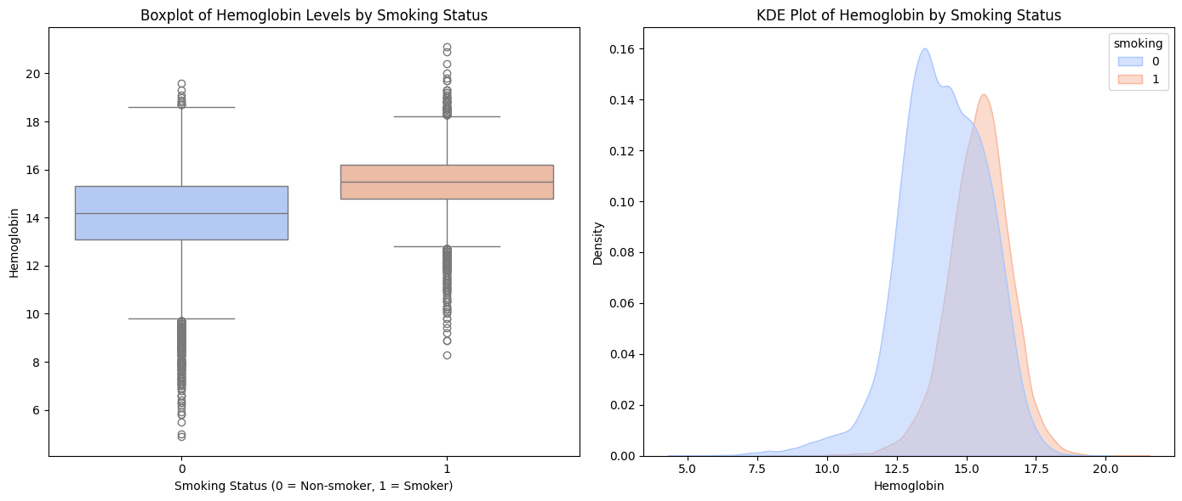
The average hemoglobin levels are notably higher in smokers compared to non-smokers. This observation could be indicative of a physiological response to smoking
Bivariate Analysis

Slide 18
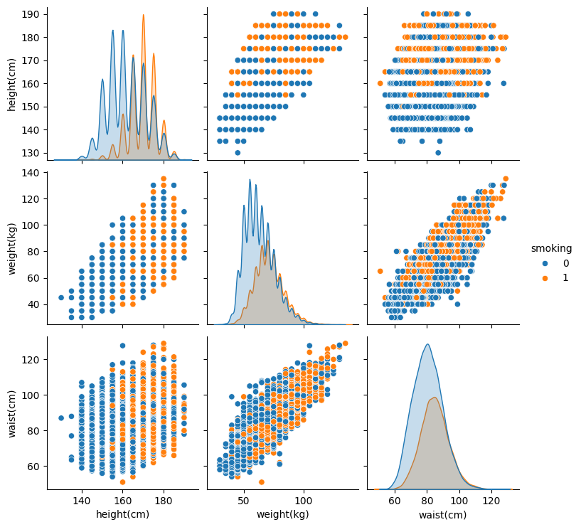
From the above pair-plots : Taller people (heavier as well) tend to smoke. The relationship between weight(kg) and waist(cm) is more or less linear
Multivariate Analysis

Slide 19
05.
Data Preprocessing
& solving data problems

Slide 20
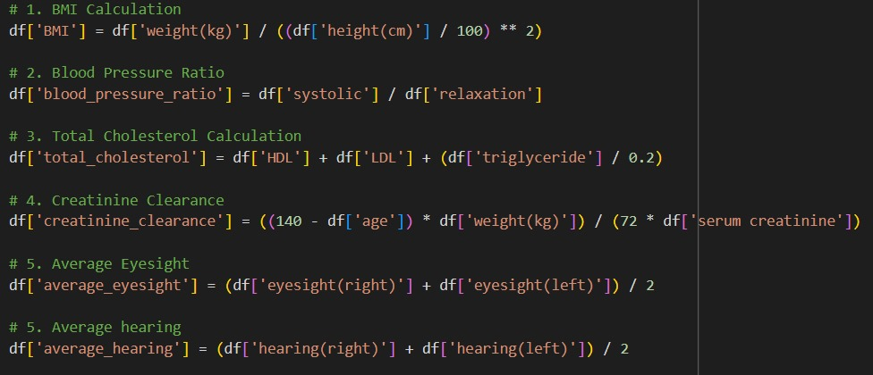
Feature Engineering
from the domain knowledge we get this equations

Slide 21
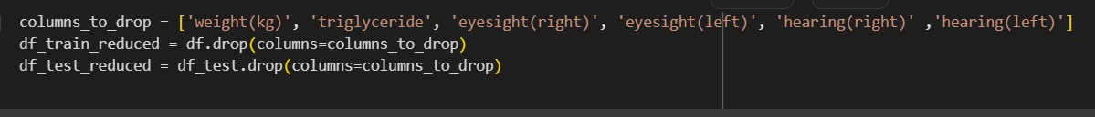
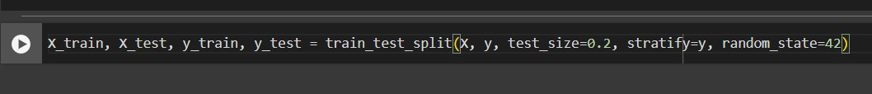
from correlation and feature importance using random forest we decided to drop this features only
we split the data using 0.2 for test and stratify to get the same portions of the lables because we notices that the data is imbalanced

Slide 22
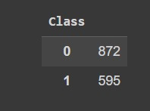
Anomaly Detection:
we checked the anomaly and drop it

Slide 23
06.
Modeling

Slide 24
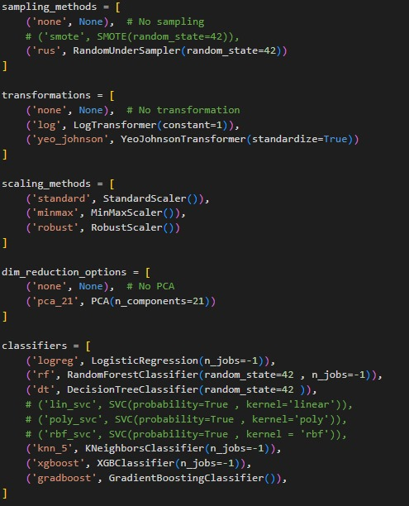
Combinations:
In the modeling we try Brute force technique to tried all the combination of the Sampling , transformation , Scaling and models

Slide 25
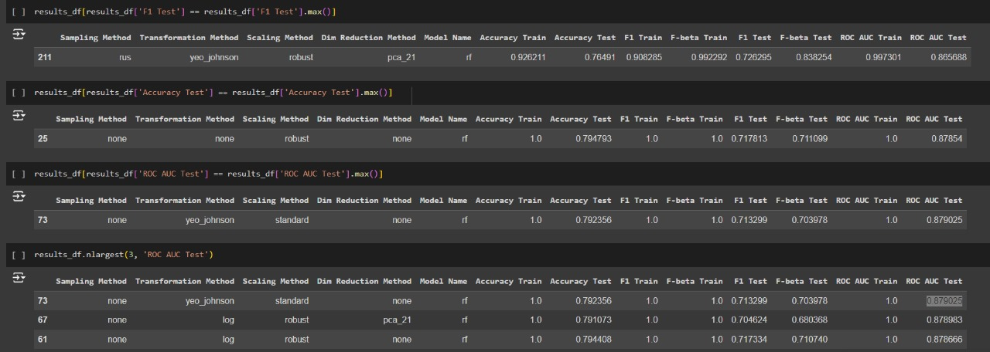
Combinations:
The highest Combinations for different Classification metrics

Slide 26
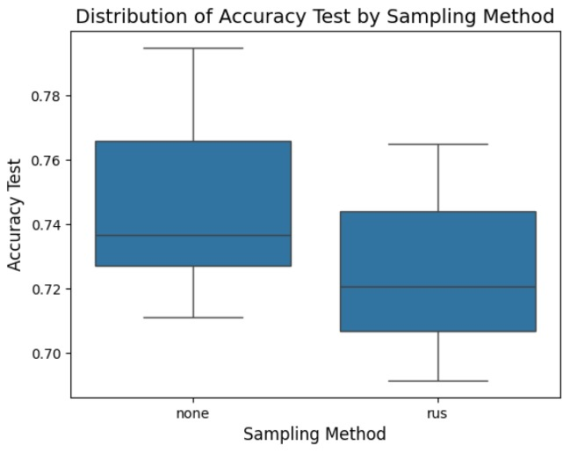
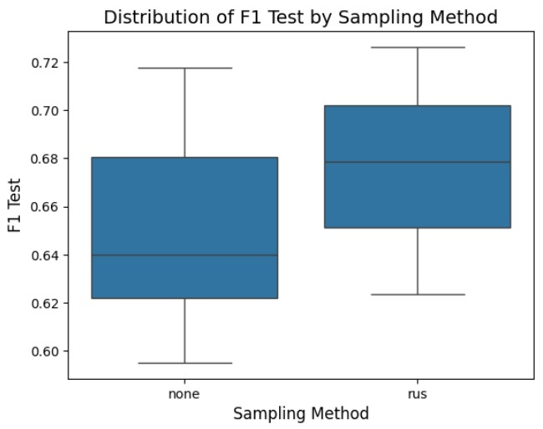
Combinations:
The distribution of different Sampling Method

Slide 27
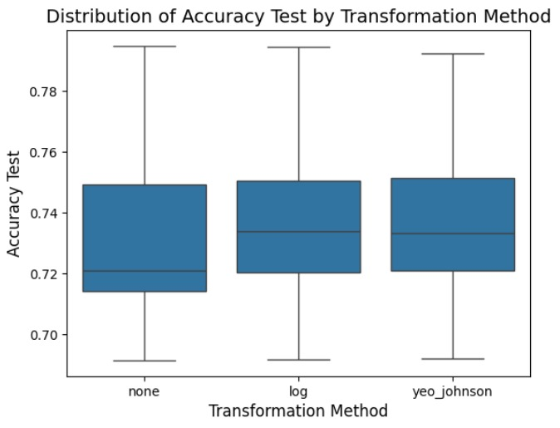
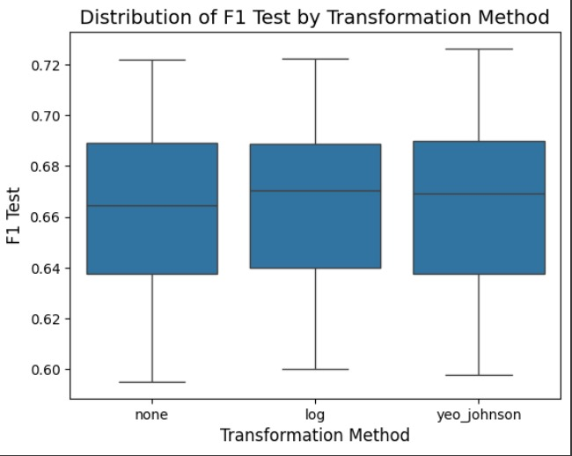
Combinations:
The distribution of different Transformation Methods

Slide 28
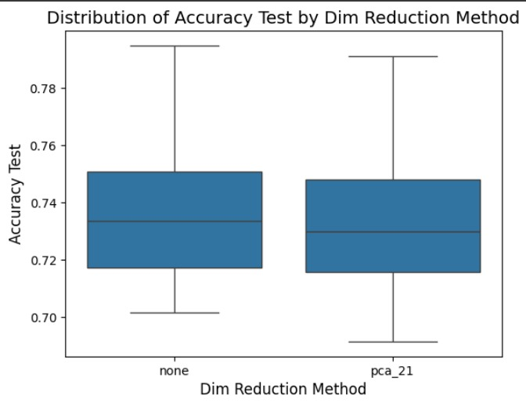
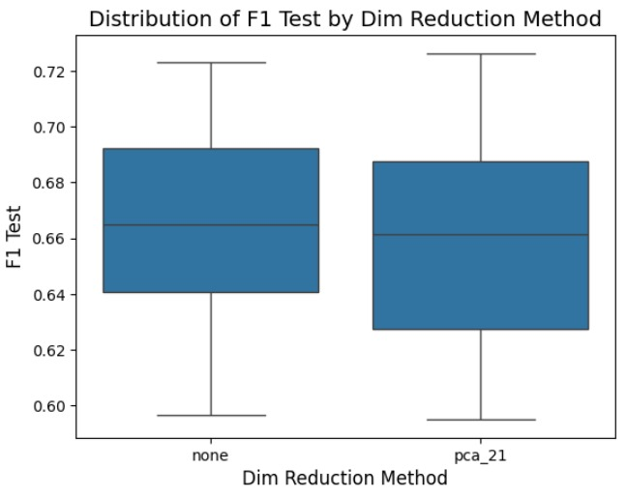
Combinations:
The distribution of different Dim Reduction Methods

Slide 29
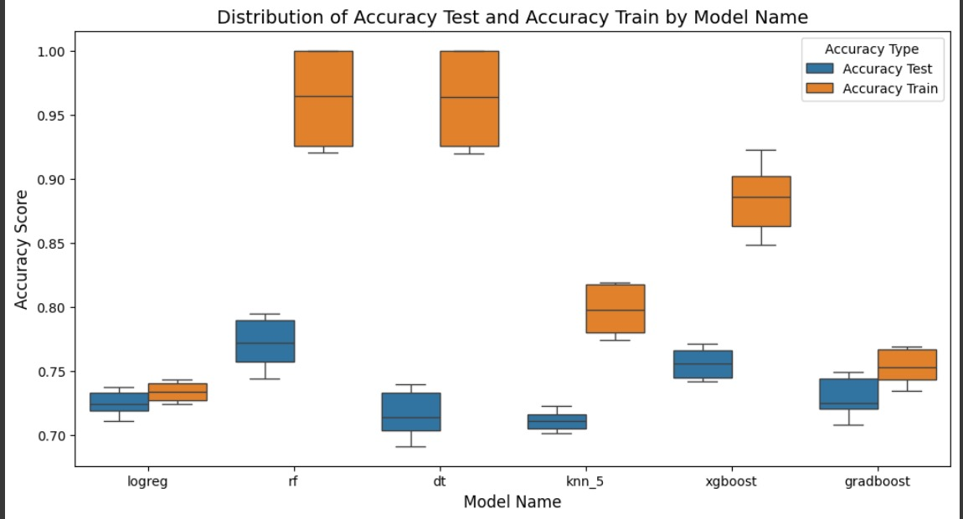
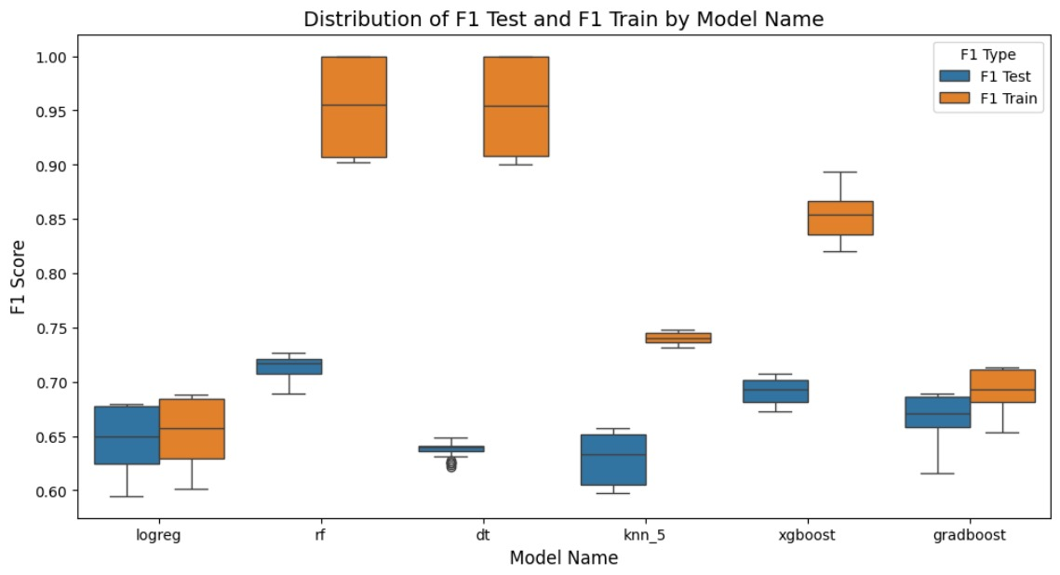
Combinations:
The distribution of different Models

Slide 30
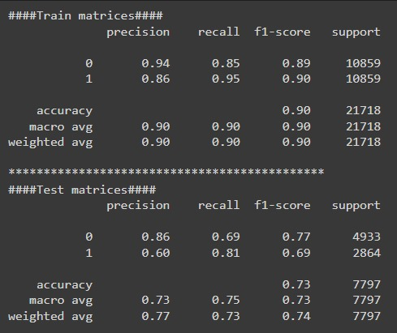
Tune the SVC Using Grid Search

Slide 31
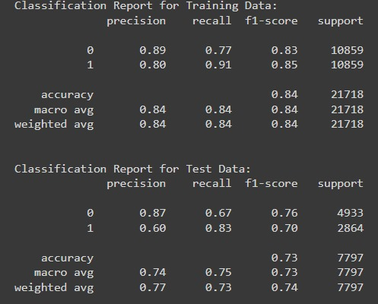
Tune the XGBoost Using Grid Search

Slide 32
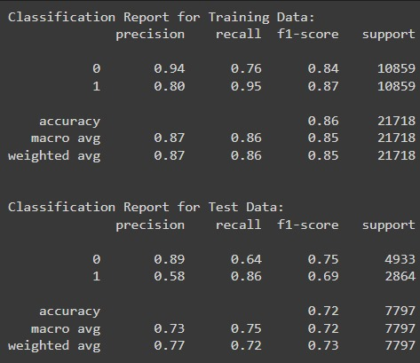
Tune the Random Forest Using Grid Search

Slide 33
Reducing Model Complexity:
We Tried To use Features Selection Filter Methods to Reduce the Model Complexity
1- Using Subsample
2- Using Correlation, ANOVA, VIF
3- See the Overlapping
4- Removing the Outliers

Slide 34
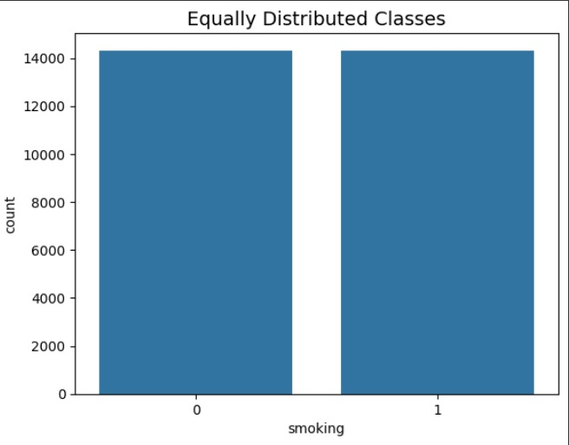
Using Subsample

Slide 35
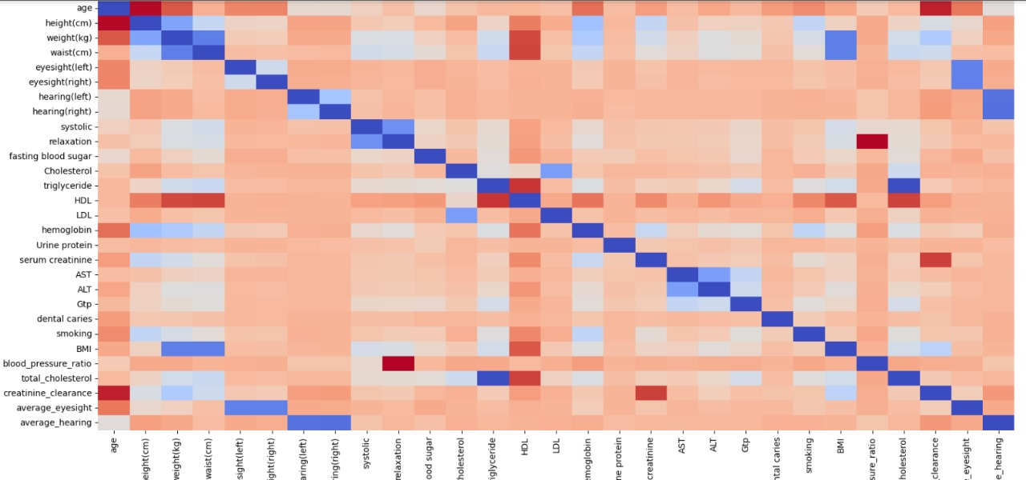
Using Correlation, ANOVA, VIF

Slide 36
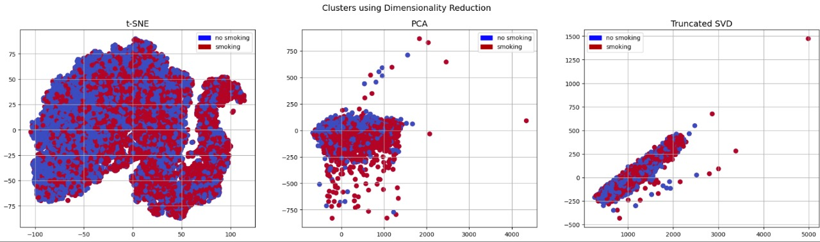
See the Overlapping

Slide 37
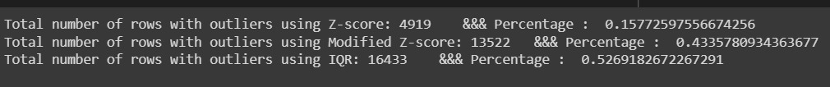
Removing the Outliers
1- Using Z-score
2- Using Modified Z-score
3- Using IQR
After see results we decide to choose Z-score

Slide 38
The result of this Approach
Using Grid Search with XGBoost we get Best F1 Score : 0.6653267551253966 😥😥😥

Slide 39
Another Approach
We tried to use only Boosting methods without any Scaling or Transformation or Sampling
We tried to get the best Parameters of each Model using Optuna

Slide 40
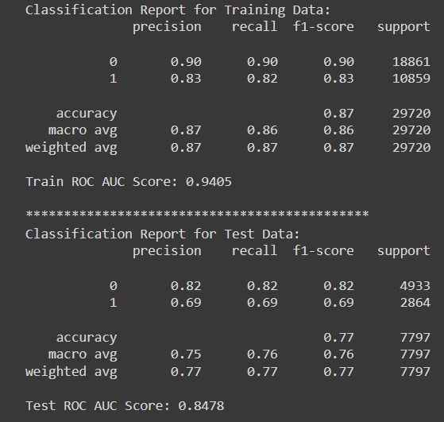
Another Approach
Best result for XGBoost:

Slide 41
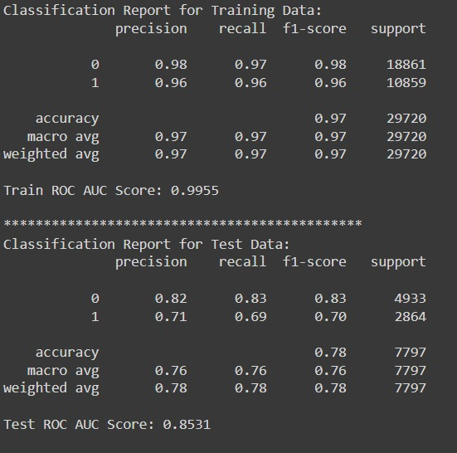
Best result for LGBM:

Slide 42
07.
Business Insights

Slide 43
we need to focus on how your insights can inform business decisions, strategies, or operational improvements. Here’s an outline of how you could approach this based on typical data-driven business outcomes:
1. Health and Interventions
Recommendation: Launch wellness programs targeting individuals with high triglycerides and cholesterol
Business Value: Lower healthcare costs and boost productivity by mitigating long-term health risks.
2. Smoking Cessation Programs
Recommendation: Implement smoking cessation programs (targeting ~36.7% smokers).
Business Value: Improve employee health, reduce sick days, and lower insurance premiums
3. Preventive Healthcare Initiatives
Recommendation: Promote regular health screenings as part of employee benefits.
Business Value: Early detection saves costs, increases longevity, and reduces absenteeism.

Slide 44
4. Lifestyle and Fitness Programs
Recommendation: Develop programs promoting healthier lifestyle choices for individuals with high BMI and waist-to-height ratios.
Business Value: Boost productivity and morale while reducing healthcare costs by addressing obesity.
5. Customized Health Insurance Plans
Recommendation: Offer premium discounts for individuals with better health metrics.
Business Value: Encourage healthy behaviors, leading to fewer insurance claims and lower premiums.
6. Data-Driven Healthcare Products
Recommendation: Partner with wellness companies to offer personalized healthcare products.
Business Value: Cater to niche markets, creating new revenue streams and boosting customer retention.
7. Health Risk Profiling and Employee Wellness Strategies
Recommendation: Develop health risk profiles to tailor wellness policies for high-risk individuals.
Business Value: A healthier workforce results in fewer sick days, higher engagement, and improved productivity.

Slide 45



OUR TEAM
Mostafa Hamada
Ibrahim Ehab
Ahmed Mohmd
Contribution: EDA
Contribution: Data Preprocessing
Contribution: Modeling

Slide 46
Any Questions!

Slide 47


